Slide 1


Mobility Models in Mobile Computing
Presented By
NAVEEN.S 192324248
Course Code & Name: ITA03
Mobile Computing

Slide 2
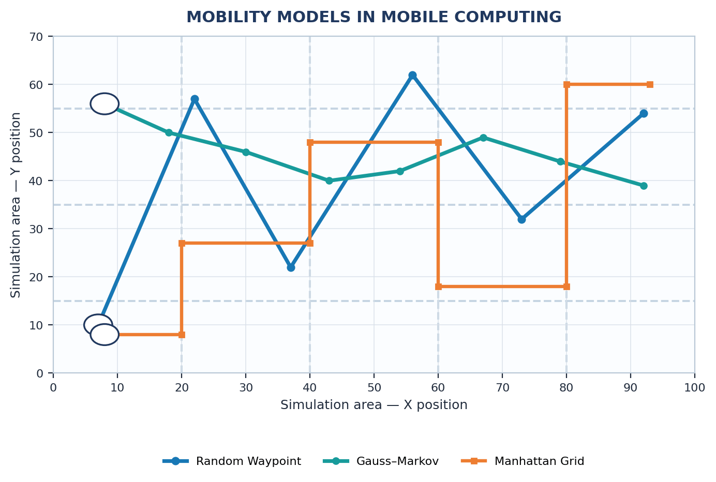
Introduction
This presentation examines mobility models used to represent movement of mobile devices, people, and vehicles in mobile computing environments.
Mobility traces describe how nodes change position, speed, and direction as time progresses.
Common models include Random Waypoint, Random Walk, Random Direction, Gauss–Markov, and Manhattan Grid.
Each model produces different movement patterns and affects wireless connectivity and network topology.
We compare these movement patterns using node trajectories and key parameters such as speed, pause time, and travelled distance.
The technical focus is to explain how mobility assumptions affect simulation realism and the evaluation of mobile network protocols.

Slide 3
Scenario & Parameter Configuration
Scenario Definition:
  Define the simulated environment, including area size, node count, initial positions, run duration, and whether movement represents pedestrians, vehicles, or general mobile users.
  Choose models that fit the application, such as Random Waypoint for general movement and Manhattan Grid for travel constrained by roads.
Model Configuration:
  Set node speed ranges, pause time, direction changes, waypoint selection, and boundary-handling rules.
  Use consistent parameters and random seeds so that different models can be compared fairly.
  Save the settings in a structured configuration for repeatable simulation and later performance analysis.

Slide 4
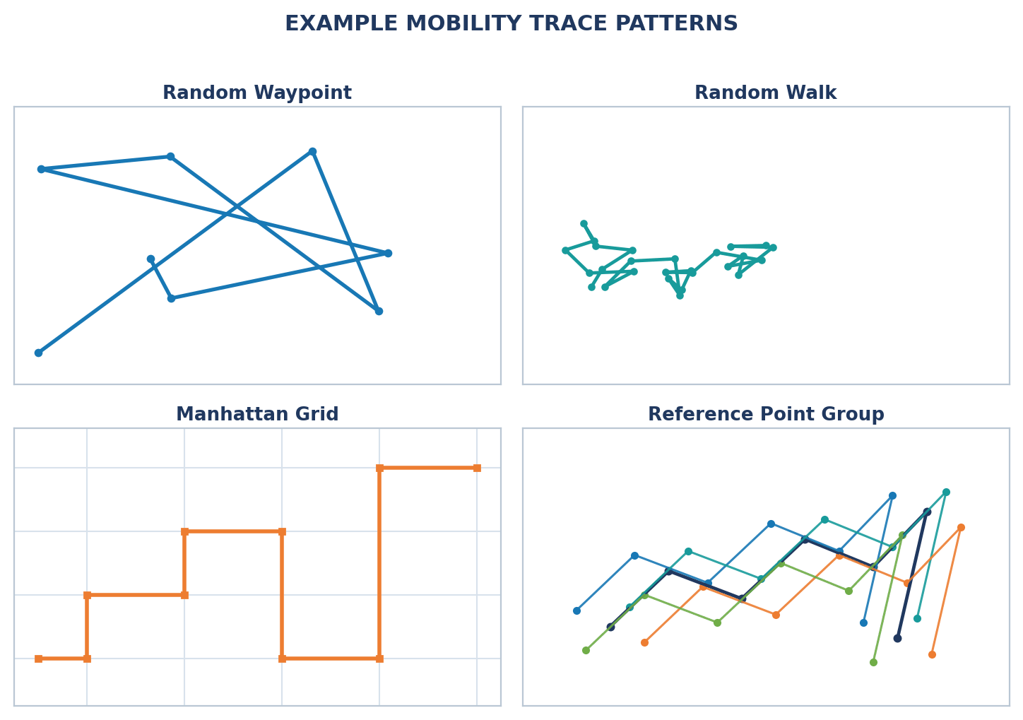
Simulation Inputs & Trace Data
Core Simulation Inputs:
Take input for:
Simulation area, duration, and number of mobile nodes
Initial node positions and node speed ranges
Selected model and movement parameters (waypoints, pause time, direction rules)
Initialize arrays to store each node’s position coordinates over time for trajectory plotting and mobility analysis

Slide 5
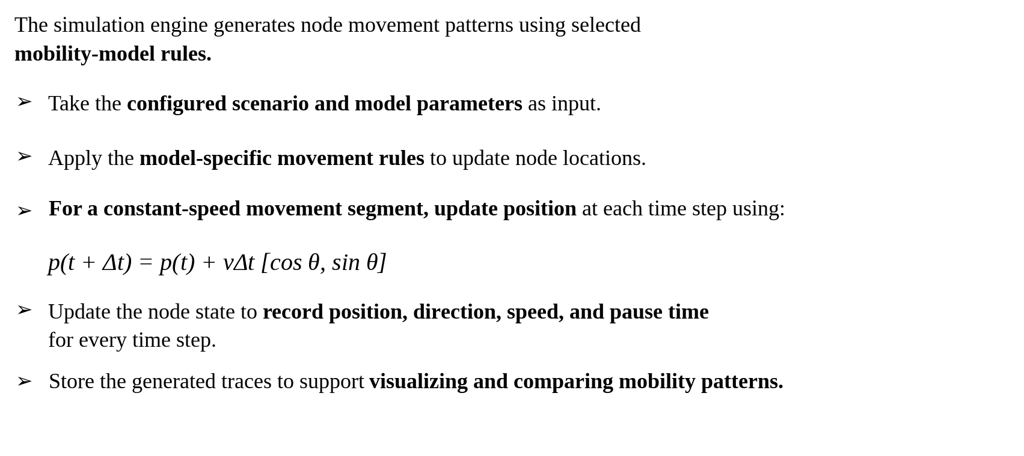
Mobility Update Algorithm
The simulation engine generates node movement patterns using selected mobility-model rules.
Take the configured scenario and model parameters as input.
Apply the model-specific movement rules to update node locations.
For a constant-speed movement segment, update position at each time step using:
$p(t+Δt)=p(t)+vΔt[cosθ, sinθ]$
Update the node state to record position, direction, speed, and pause time for every time step.
Store the generated traces to support visualizing and comparing mobility patterns.

Slide 6
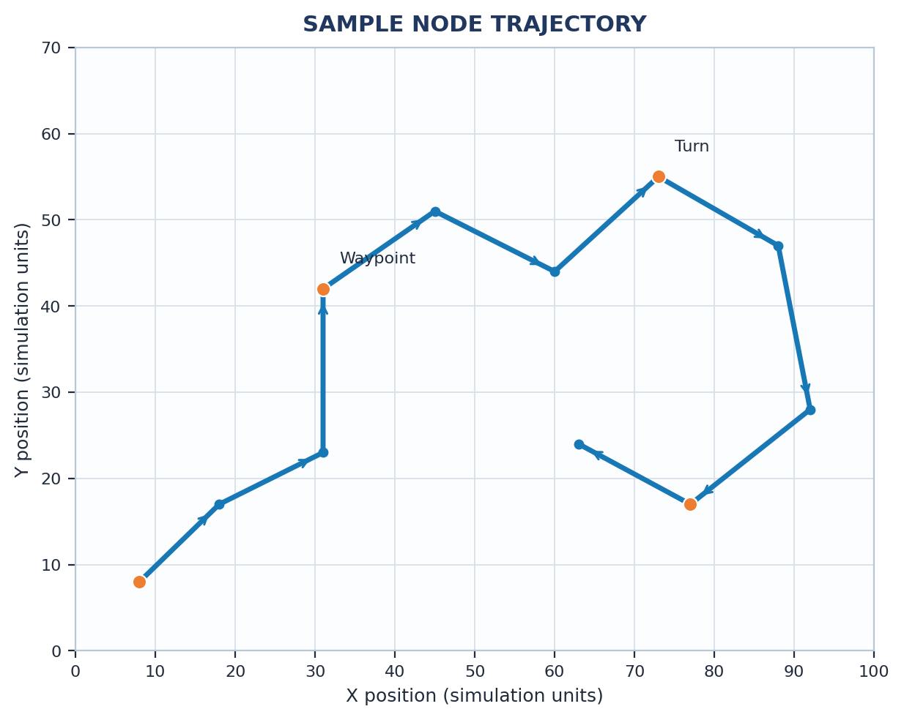
Trajectory Visualization & Output
Trajectory Insights
The plot shows an example of node movement across the simulation area, with positions changing over time.
The trajectory reveals waypoint-based movement and direction changes, making model behavior easier to interpret.
Distinct turning points and pause periods illustrate how movement rules affect the path.
The graph supports quick inspection of travel paths and movement spread, demonstrating the value of visual analytics.

Slide 7
Performance Results & Discussion
Key Findings
The trajectory comparison reveals distinct movement patterns across the selected mobility models.
Different movement rules influence node location, connectivity, and contact opportunities by changing direction, speed, and pause behavior.
The analysis confirms that consistent parameters and clear visualizations support fair model comparison.
The results demonstrate that mobility-aware simulation is important for evaluating mobile network protocols.

Slide 8
Future Directions
Realistic Hybrid Mobility Models:
Combine random movement with road networks and constraints to represent pedestrians, vehicles, and mixed urban environments.
AI-Based Mobility Prediction:
Use learning algorithms to estimate next positions and adapt movement parameters from observed traces.
5G and Edge-Aware Mobility:
Study how movement, handovers, and changing connectivity affect mobile application quality and edge-server selection.
Large-Scale Urban Simulation:
Integrate maps, public transport, crowds, and group movement for realistic city-scale scenarios.
Interactive Mobility Dashboard:
Add trajectory playback, side-by-side model comparison, and automatic summaries of movement and network metrics.

Slide 9
Conclusion
Mobility models provide a structured way to represent the movement of devices, users, and vehicles in mobile computing.
The study demonstrates that speed, pause time, direction changes, and area constraints directly influence generated trajectories and node connectivity.
Random Waypoint, Random Walk, Gauss–Markov, Manhattan Grid, and group mobility models represent different conditions, so model selection should match the intended scenario and the network environment being evaluated.
Trajectory visualizations and consistent simulation settings provide clear insights into movement behavior and support informed evaluation of mobile network protocols.

Slide 10
THANK YOU.

